Slide 1

CHAPTER 2: INSTRUCTIONs AND I/O PORT PROGRAMMING

Slide 2
Contents
2.1 Arithmetic instructions
2.2 Singed number concepts and arithmetic operations
2.3 Logic and compare instructions
2.4 Rotate instruction and data serialization
2.5 BCD and ASCII converasion
2.6 Call instructions and stack (126)
2.7 Time delay and pipeline
2.8 I/O programming

Slide 3
2.1 Arithmetic instructions
Addition of unsigned numbers:
Syntax:
ADDLW K ; WREG= WREG + K
  The sum is stored in the WREG register.
  Change C, DC, Z, N, or OV bits of the status register.
Example 2.1.
  How the flag register is affected by the following instructions
  MOVLW 0xF5 ;
  ADDLW 0xB ;

Slide 4
Addition (2)
Solution:
  MOVLW 0xF5 ; WREG=F5 hex
  ADDLW 0xB ; WREG= F5+ 0B = 00 and C=1
F5 1111 0101
+ 0B + 0000 1011
100H 0000 0000
  C=1 ; a carry out from D7
  Z=1 ; the result in WREG is zero
  DC=1; a carry from D3 to D4

Slide 5
Addition (3)
ADDWF (addition of individual bytes)
  Syntax: ADDWF fileReg, d
  Description:
    Add contents of register W to register f
    If d=0, result is stored in W register.
    If d=1, result is stored in f register.
ADDWFC (addition of 16-bit numbers)
  Syntax: ADDWFC fileReg, d ;
  Description:
    ADDW and fileReg with carry

Slide 6
Subtraction of unsigned numbers
Structure:
SUBLW K ; WREG= K- WREG
The steps of the hardware in executing:
  Take the 2’s complement of the subtrahend (WREG operand).
  Add it to the minuend (K operand)
Example 2.2 : Show the steps involved in the following.
  MOVLW 0x23 ; 23h=0010 0011, Lấy đảo của 23h: 1101 1100 (lấy bù 1)
  SUBLW 0X3F ; + 1
  1101 1101 (bù 2 của 23)

Slide 7
Subtraction (2)
Solution:
  MOVLW 0x23 ; load 23H into WREG (WREG=23H)
  SUBLW 0X3F ; WREG=3F-WREG
K = 3F 0011 1111
- WREG = 23 + 1101 1101 1C 1 0001 1100
C=1, N=D7=0 (result is positive)

Slide 8
Subtraction (3)
Example 2.3: Write a program to subtrac 4C-6E.
Solution:
MYREG EQU 0x20
MOVLW 0x4C ; load WREG=4C
MOVWF MYRREG ; MYREG=4CH
MOVLW 0x6E ; WREG=6E
SUBWF MYREG, W ; WREG=MYREG – WREG=4C-6E=DE, N=1
BNN NEXT ; if N=0 (C=1) jump to NEXT target
NEGF WREG ; take 2’s complement of WREG
NEXT MOVWF MYREG ; save the result in MYREG

Slide 9
Subtraction (4)
SUBWFB (Subtract W from f with borrow)
  Syntax: SUBWFB fileReg
  Description: dest = fileReg – W – Borrow
SUBFWB
  Syntax: SUBFWB fileReg {d,{a}}
  Description: dest = WREG – fileReg – Borrow

Slide 10
Multiplication of usigned numbers
Syntax: MULLW k
Description: multiply k ⅹ WREG -> PRODH: PRODL
Example :
MOVLW 0X25 ; load 25H to WREG
MULLW 0X65 ; 25H * 65H = E99 where
; PRODH= 0EH and PORDL = 99H.

Slide 11
Multiplication (2)
MULWF
  Syntax: MULWF fileReg
  Operation: (W) x (f) -> PRODH : PRODL

Slide 12
Division of unsigned numbers
There is no single instruction for the division of byte/ byte numbers in the PIC18.
Performing division by repeated subtraction.

Slide 13
Review questions
In multiplication of two bytes in the PIC 18, we can place one byte in register …….. And for the other one we can use value K.
In unsigned byte – by – byte multiplication, the product wi;; be placed in register(s)………
Is “MULLW F” a valid PIC18 instruction? Explain your answer.
In PIC18, the largest two numbers that can be multiplied are …. and ……
The instruction “ADDLW K” places the sum in ……..
Why is the following ADD instruction illegal? “ADDLW fileReg”
Find the value of the DC and C flags in each of the following.
MOVLW 0x4F b. MOVLW 0x9C
ADDLW 0xB1 ADDLW 0x63
Show how the CPU would subtrct 05H from 43H.
If C=1, WREG=95H, and fileReg=4FH prior to the execution of “SUBFWB fileReg, F” what will be the contents of WREG and fileReg after the subtraction?

Slide 14
2.2 SIGNED NUMBER CONCEPTS AND ARITHMETIC OPERATIONS
Signed 8-bit operands
Positive numbers
Negative numbers
Overflow problem in signed number operations
When is the OV flag set?

Slide 15
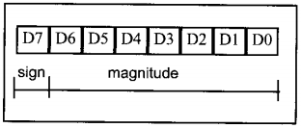
Signed 8-bit operands
D7 (MSB) is the sign
  D7=0 : positive
  D7=1: negative
D0 to D6 are set aside for the magnitude of the number
N flag (in the status register) is the D& bit
8-bit signed operand

Slide 16
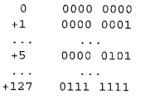
Positive numbers
Range of positive numbers is 0 to +127

Slide 17

Negative numbers
To convert to negative number representation (2’s complement), follow these steps:
  Write the magnitude of the number in 8-bit binary (no sign)
  Invert each bit
  Add 1 to it
Example: How the PIC would represent -5:
Solution:
  Obsever the following steps:

Slide 18
Overflow problem in signed number operations
What is an overflow?
  The result of an operation on signed numbers is too large for the register
Example: Examine the following code and analyze the result, including the N and OV flags.
MOVLW +D’96’ ;
ADDLW +D’70’ ;
Solution:
+ 96 0110 0000
+ +70 0100 0110
+166 1010 0110 N=1 and OV=1. Sum = -90
Result is negative (N=1) which iss wrong. OV=1 to indicate the overflow error.

Slide 19
When is the OV fag set?
OV is set to 1 if either of the following two conditions occurs:
  There is a cary from D^ to D7 but no carry out of D7 (C-0)
  Ther is a carry from D7 out (C=1) but no carry from D6 to D7

Slide 20
Review Questions
In an 8-bit operand, bit …………. is used for the sign bit.
Convert -16H to its 2’s complement representation.
The range of byte-sized signed operands is -… to + ….
Show +9 and -9 in binary.
Explain the difference between a carry and an overflow.

Slide 21
2.3 Logic and compare instructions
AND
OR
XOR
COMF
NEGF
Compare instructions

Slide 22
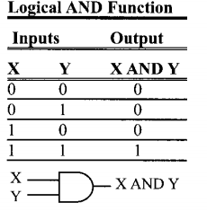
AND
Syntax:
ANDLW k
Operation: WREG = WREG and k
Affected flags are Z and N flags.
Example: Show the result of the following
MOVLW 0x35 ;
ANDLW 0x0F ;
Solution:
35H 0 0 1 1 0 1 0 1
0FH 0 0 0 0 1 1 1 1
05H 0 0 0 0 0 1 0 1 ; 35H and 0FH=05H , Z=0,N=0

Slide 23
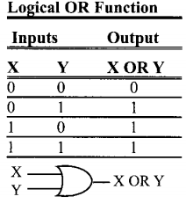
OR
Syntax:
IORLW k;
Operation: WREG= WREG Inclusive-OR K
Affected flags: Z and N
Example:
Show the results of the following:
MOVLW 0x04 ;
IORLW 0x30;
b. Assume that port B bit RB2 is used to control an outdoor light, and bit RB5 to control a light inside a building. Show how to turn “on” the outdoor light and turn “off” the inside one.

Slide 24
OR (2)
Solution
04H 0000 0100
30H 0011 0000
34H 0011 0100 , Z=0 and N=0
b.
BCF TRISB,2 ; make RB2 an output
BCF TRISB,5 ; make RB5 an output
MOVLW B ‘00000100’ ; D2=1
IORWF portB, f ; make RB2=1 only
MOVLW B’11011111’ ; D5=0
ANDWF portB, f ; mask RB5=0 only.

Slide 25
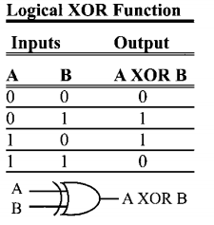
XOR
Syntax:
XORLW k ; WREG=WREG xor k
affected flags: Z and N
XORWF fileReg, W

Slide 26
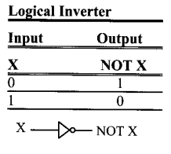
COMF (Complement fileReg)
Changes the 0s to 1s and the 1s to 0s.
Example:
CLRF TRISB ; Port B= ouput
MOVLW 0x55H
MOVWF PORTB
COMF PORTB,f ; portB=AAH

Slide 27
NEGF (negata fileReg)
takes the 2’s complement of a file register.
Example: Find the 2’s complement of the value 85H. Note that 85H is -123.
Solution:
MYREG EQU 0x10
MOVLW 0x85 85H= 1000 0101
MOVWF MYREG 1’s = 0111 1010
NEGF MYREG + 1
2’s comp 0111 1011 =7BH

Slide 28
Compare instructions
CPFSGT | Compare FileReg with WREG, skip if greater than | FileReg > WREG
CPFSEQ | Compare FileReg with WREG, skip if equal | FileReg = WREG
CPFSLT | Compare FileReg with WREG, skip if less than | FileReg < WREG

Slide 29
Review questions
Find the content of register WREG after the following code in each case:
MOVLW 0x37 b. MOVLW 0x37 c. MOVLW 0x37
ANDLW 0xCA IORLW 0xCA XORLW 0xCA
To mask certain bits of the WREG, we must AND it with ……
To set certain bits of the WEG to 1, we must OR it with……
EX-Oring an operand with itself serults in ….
True or false. The CPFSLT instructions alters the contents of its operands
Find the contents of register WREG after execution of the following code:
MOVLW 0
IORLW 0x99
XORLW 0x99

Slide 30
2.4 ROTATE INSTRUCTION AND DATA SERIALIZATION
Rotating the bits of fileReg right or left
Rotating through the carry
Serializing data
Serializing a byte of data
SWAPF fileReg, d

Slide 31

Rotating the bits of fileReg right and left
Syntax:
RRNCF fileReg,d ; rotate fileReg right (no carry)

Slide 32

Rotating through the carry
Syntax:
RRCF fileReg , d ; rotate fileReg right through carry

Slide 33
Serializing data
Two ways to transfer a byte of data serially:
  Using the serial port.
  Transfer data one bit at a time and control the sequence of data and spaces between them.

Slide 34
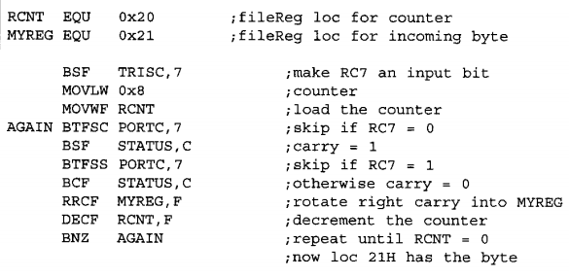
Serializing a byte data
using the rotate instruction to tranfer a byte of data serially.
Example: Write a program to transfer value 51H serially (one bit at a time) via pin RB1. Put one high at the start and end of the data. Send the LSB first.
Solution:

Slide 35
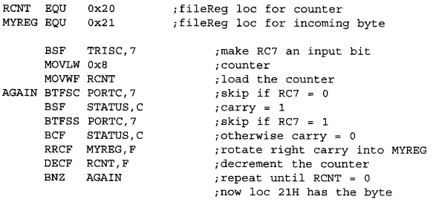
Serializing a byte data (2)
Example: Write a program to bring in a byte of data serially (one bit at a time) via pin RC7 and save it in file register location 0x21. The byte comes in with the LSB first.
Solution:

Slide 36
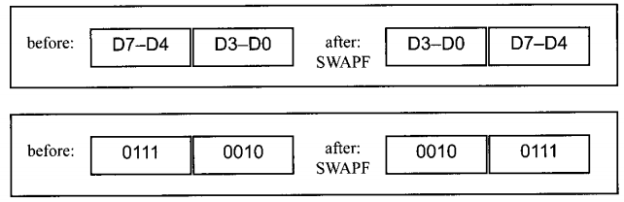
SWAPF fileReg, d
swapf work on the file Register, it swaps the lower nibble and the higher nibble.

Slide 37

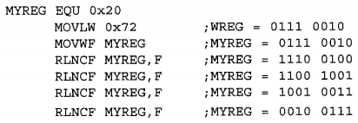
SWAPF (2)
Example:
  Find the contents of the MYREG register in the following code.
  In the absence of a SWAPF instruction, how would you exchange the nibbles? Write a simple programe to show the process.
Solution:
  a. b.

Slide 38
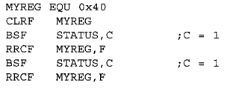
Review questions.
What is the value of MYREG in the file register after the following code is excuted?
MYREG EQU 0x40
MOVLW 0x25
MOVWF MYREG
RRNCF MYREG,F
RRNCF MYREG, F
RRNCF MYREG,F
RRNCF MYREG,F
2. What is the value of MYREG in the file register after the following code is excuted?

Slide 39
BCD AND ASSCII CONVERSION
ASCII numbers
Packed BCD to ASCII conversion

Slide 40
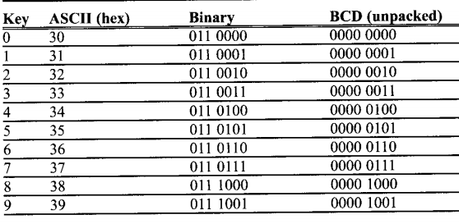
ASCII number
BCD numbers are universal.
The keyboard, printers, and monotors all use ASCII
How does data get converted from ASCII to BCD, and vice versa?

Slide 41

Packed BCD to ASCII conversion
Converting packed BCD to ASCII:

Slide 42

ASCII to packed BCD conversion
2 steps converting ASCII to packed BCD
  Convert it to unpacked BCD
  Combine it to make packed BCD

Slide 43
Review questions
For the following decimal numbers, give the packed BCD and unpacked BCD representation:
15 b. 99
2. Show the binary and hex formats for “76” and its BCD version
3. Does the WREG register have BCD data after the following instructions in excuted?
MOVLW D ‘54’
4. 67H in BCD when converted to ASCII is ….H and ….H
5. Does the following convert unpacked BCD in the WREG register to ASCII?
MOVLW 0x09
ADDLW 0x30

Slide 44
2.6 Call instructions and stack
CALL
RCALL (relative call)

Slide 45
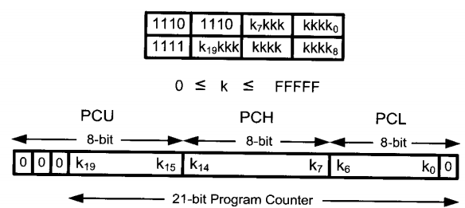
CALL
4-bytes (32 bit) instruction :
  12 bits: opcode
  20 bits (A21-A1): address of the target subroutine.
Call instruction

Slide 46
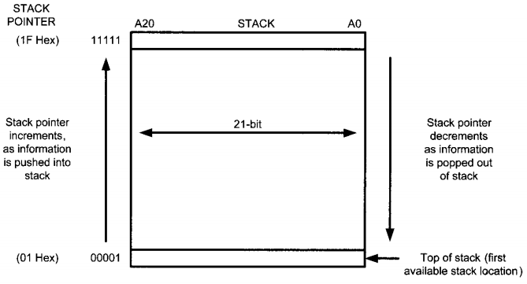
Stack and stack pointer

Slide 47
Example
Toggle all the bits of the SR register of Port B by sending to it the value 55H and AAH continuously. Put a time delay in between each issuing of data to port B.

Slide 48
RCALL
RCALL is a 2-byte instruction
The target address of the subroutine is 2K
Example: Rewire the main part of previous example as effeciently as you can.

Slide 49
Review questions.
How wide is the size of the stack in the PIC18?
True or false. In the PIC19, control can be transferred anywhere withing the 2M of code space by using the CALL instruction.
The CALL instruction is a(n) …. – byte instruction.
True or false. In PIC18, control can be transferred anywhere withing 2M of code space by using the RCALL instruction.
How deep is the size of the stack in the PIC18?

Slide 50
2.7 Time delay and instruction pipeline
Delay calculation
Pipelining
Instruction cycle time for the PIC
Branch penalty
Loop inside a loop delay
PIC multistage execution pipeline

Slide 51
Delay calculation
Two factors affect the accuracy of the delay:
  The crystal frequency: The duration of the closk period for the instruction cycle is a function of this crystal frequency.
  The PIC design:

Slide 52
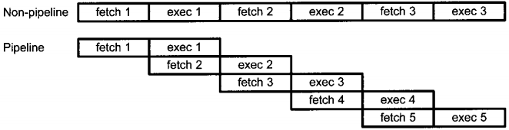
Pipelining
Pipelining allow the CPU fetch and excute at the same time.

Slide 53
Instruction cycle time for the PIC
Instruction cycle: amount of time for the CPU to execute an instruction.
The instructions in the PIC18 are either 2-byte or 4-byte -> take more than one or two instruction cycles to execute.
One instruction cycle consists of four oscillator periods
to caculation the instruction cycle for the PIC, we take ¼ of the crystal frequency, then take its inverse

Slide 54
Instruction cycle time for the PIC (2)
Example: The following shows the crystal frequency for three different PIC – based systems. Find the period of the instruction cycle in each case.
a. 4Mhz b. 16Mhz c. 20MHz
Solution:
4/4=1 MHz, instruction cycle is 1/1 MHz = 1us
16/4 Mhz=4MHz, instruction cycle= 1/4Mhz= 0.25us
20/4Mhz= 5Mhz, instruction cycle=1/5 Mhz= 0.2us

Slide 55
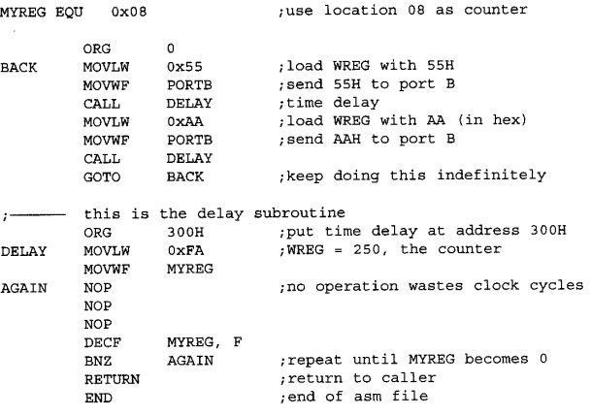
Delay calculation(2)
A delay subroutine consist of 2 parts:
  Setting a counter
  a loop
Example: find the sixe of the delay in the following program if the crystal frequency is 4Mhz.

Slide 56
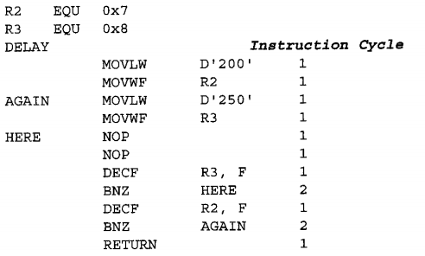
Loop inside a loop delay
Example: For a instruction cycle of 1us, fid the time delay in the following subroutine.

Slide 57
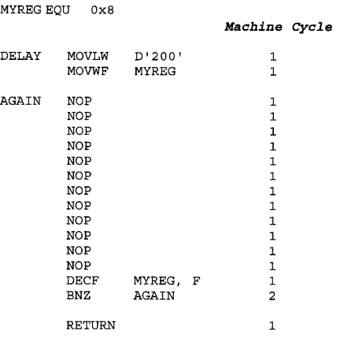
Loop inside a loop delay (2)
Example: Find the time delay for the following subroutine, assuming a crystal frequency of 4 Mhz. Discuss the disadvantages of this over previous example.

Slide 58

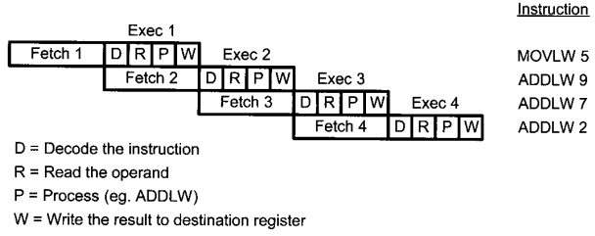
PIC multistage execution pipeline
The execution unit takes 4 clock perids of the oscillator.
Q1: decoding the instruction that is already fetched and sitting in the queue.
Q2: the operand is fetched from the file register.
Q3: operation is performed
Q4: result is writen into the destination register.
Pipeline activity for both fetch and execute

Slide 59
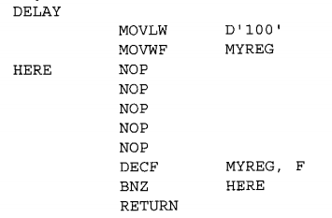
Review questions
True or false. The instruction cycle lasts 4 clock periods of the crystal frequency.
The minimun number of instruction cycle needs to execute a PIC 18 instruction is ….
For question 2. what is the maximum number of cycles neeeded, and for which instructions?
Find the instructuon cycle for a crustal frequency of 12 Mhz.
Assuming a crystal frequency of 4 Mhz, find the time delay associated with the loop section of the following DELAY subroutine:

Slide 60
2.8 I/O port programming
List all the ports of the PIC18
Describle the dual role of PIC18 pins
Code assembly language to use the ports for input or output.
Explain the dual role of Ports A, B, C, and D.
Code PIC instructions for I/O handling
CodeI/O bit-manipulation programs for the PIC
Expalin the bit-addressability of PIC ports

Slide 67
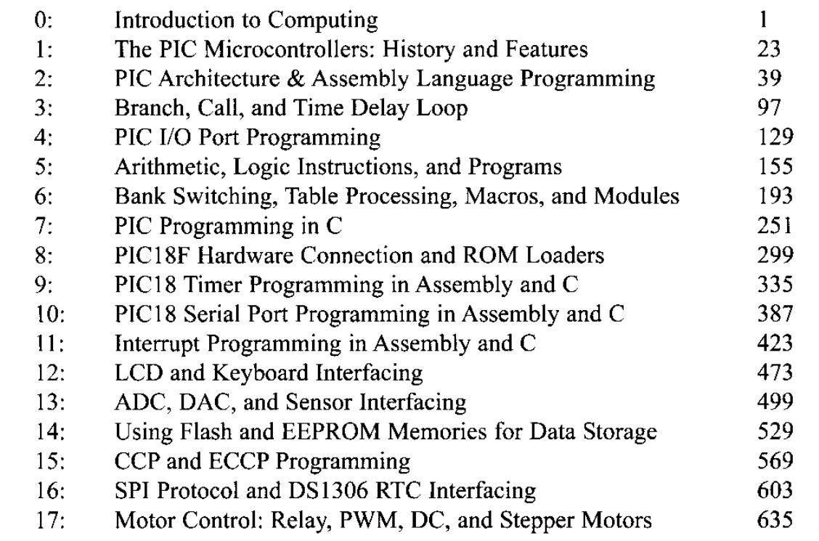

Slide 68
Chúc các em thành công
trên con đường đã chọn!

Slide 69
Thank You !

